Slide 1
Guided Discussion Series
The Non-aggression Principle
A complete formal statement
NAP “gray” and “problem” areas
The big optimization problem of minimizing aggression
Guide: Roy Minet

Slide 2
“THE” NAP
The same basic idea has surfaced many times as different variants over many centuries.
See especially versions and discussions by Ayn Rand and Murray Rothbard (also Hans-Hermann Hoppe).
As we found “rights” to be messier than expected, such is also the case with the NAP.
The NAP is great and powerful, but does have fuzzy or gray areas as well as “incomplete coverage.”

Slide 3
A Complete Formal NAP Statement
No societal entity (individual, organization, business, government, etc.) may engage in fraud, and may not initiate the use of force (or the credible threat of force) against any other societal entity (including the entity’s justly-owned property) for any reason, excepting that minimum amount of force which may be necessary to enforce this non-aggression principle.
Frequently, an abbreviated or “simplified” form of the NAP is used (as with the LP pledge)
Simplified NAPs usually neglect to provide for the force that will inevitably be required to enforce the NAP
This can lead to incorrect conclusions!

Slide 4
Enforcement Mechanisms To Ensure Justice
Prosecute the Guilty
And Protect the Innocent
Compelling witness testimony
Executing search warrants
Compelling jury duty
Incarceration
Execution or exile?
(All require the initiation of force.)

Slide 5
Self Defense vs Aggression
Individual defense – When is someone justified to pull the trigger?
Common defense – When is a nation-state justified to attack?
Defining clear rules is tricky and what the rules should be can be affected by time/technology advances

Slide 6
Placing Others Involuntarily
At “Undue” Risk
Can someone experiment with a dangerous virus in their basement lab?
Should certain safety requirement be forced for labs which do dangerous things?
Should people be forced to drive on the right side of roads and obey speed limits?
Should sprinklers and fire exits be required when building certain types of buildings?
Should individuals be allowed to own nuclear weapons? How about AR-15s?

Slide 7
Not Covered by NAP
Infringement of rights with no overt force or fraud
Intellectual Property (IP)
The Commons (land, atmosphere, natural resources, geo-synchronous earth orbits, the electromagnetic spectrum)
Temporal rights infringement (future generations)
Emergencies
Public goods and economic “free rider” problems

Slide 8
NAP Summary
The NAP is a great, good, powerful, easy-to-understand and attractive underlying principle with broad applicability.
The NAP is a key pillar for forming a civil society, but is insufficient by itself.
  Complex gray or fuzzy areas need further specification
  Some important areas which the NAP does not cover
How the NAP is to be enforced is important and cannot be ignored or swept under the carpet.

Slide 9
Enforcing the NAP
The purpose of the NAP is to eliminate aggression against individuals who are both peaceful and honest. Unfortunately, aggression can never be entirely eliminated. Minimizing it is an optimization problem.
Anarchy, where NAP enforcement would fall to individuals, groups (gangs?) or private entities of some sort seems very unlikely to be an optimal solution.
In the real world, anarchies appear to be unstable and evolve toward some kind of structure.
  Norman England evolved common law.
  Medieval Iceland (an anarcho-capitalist favorite) citizens eventually voted to have the king of Norway take over enforcement.

Slide 10
Optimizing Enforcement to Minimize Aggression
“Distributed” enforcement likely would suffer from higher total costs as well as inconsistency.
“Consolidated” enforcement would be expected to be more efficient (lower total cost) and provide uniformity (likely to eliminate some problems). It would draw clear, unequivocal lines in gray areas and handle areas not covered by the NAP as well.
Since individuals’ resources are consumed in either case, lower total cost results in less total aggression against individuals’ assets.
Obviously, any such enforcement must kept small so as to reduce aggression rather than increase it.

Slide 11
Paying for Enforcement
With distributed enforcement, individuals voluntarily contract with a “protection” or “insurance” company. (However, medieval Iceland had no major “not covered by NAP” issues, therefore no economic free rider problems. AnCaps tend to ignore this.)
With consolidated enforcement, it’s taxes! These should be viewed as fees for services rendered. The big problem for libertarians is that taxes cannot be voluntary because of the economic free rider problem.
The (unsatisfying to libertarians) attempt to justify this is to call it “the social contract.”

Slide 12
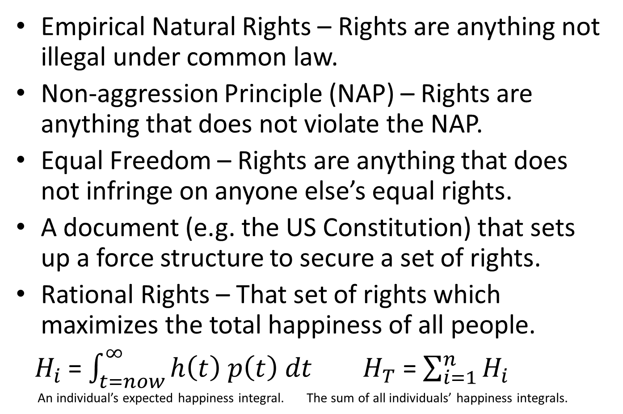
How Could Rights Be Defined?
Empirical Natural Rights – Rights are anything not illegal under common law.
Non-aggression Principle (NAP) – Rights are anything that does not violate the NAP.
Equal Freedom – Rights are anything that does not infringe on anyone else’s equal rights.
A document (e.g. the US Constitution) that sets up a force structure to secure a set of rights.
Rational Rights – That set of rights which maximizes the total happiness of all people.
${ H}_{i}$ = $\int_{t=now}^{∞}{h\left(t\right) p\left(t\right) dt}$ $H_{T}$ = $\sum_{i=1}^{n}{H_{i}}$
An individual’s expected happiness integral. The sum of all individuals’ happiness integrals.

Slide 13
So, What To Do About Rights?
It is indeed encouraging that all approaches lead to a set of rights that include the Lockean natural rights of life, liberty and property!
We could do far, far worse than the “Empirical Natural Rights” that evolved with common law.
“Rational Rights,” rights derived from the NAP and “Equal Freedoms” do not come with a clear list of rights and a force structure to secure them.
Best Plan: Very carefully design and implement a force structure to secure a “good” set of rights; pay extra heavy attention to safeguards that will keep it under control this time! (This is still risky.)

