Slide 1
Guided Discussion Series
Replacing Plurality Voting
Elections are NOT working well! The largest single problem
is continued use of the Plurality voting method.
Guide: Roy Minet

Slide 2
The Largest Single Identifiable (and fixable) Obstacle to Anyone Becoming Truly and Seriously Competitive With the Two Old Declining Parties Is Continued Use of the Plurality Voting Method !

Slide 3
What’s Wrong With Plurality ?
Does not gather enough information from voters to support reliably identifying the correct winner in many elections.
The single datum it does gather is frequently bogus. Voters vote insincerely (strategically) for the “lesser evil.”
It easily can and does elect candidates that more voters dislike than like! This should never happen. (Duh!)
Plurality actually is a main cause of the increasing polarization and divisiveness we are experiencing.

Slide 4
How Plurality Causes Polarization
Most election races are decided by just a few percentage points.
Since turnout normally is only 20% to 60%, the best strategy to win is to nominate “extreme” polarizing candidates who will drive a few additional points of turnout of “base voters.” (Especially since it’s virtually impossible to attract votes from “the extreme opposite side.”)
Thus, polarization keeps on getting worse and there is no way to escape from this destructive positive feedback loop.

Slide 5
A Very Brief History
A number of different voting methods have been used over the centuries, but Plurality is used most often because of its extreme simplicity (it’s too simple).
In the late 1700’s, two French scholars (Nicolas de Condorcet and Jean-Charles de Borda) pointed out serious deficiencies with Plurality and kicked off the quest for a good voting method.
The quest has continued for 250 years! Hundreds of voting methods have been proposed, analyzed and debated without any resolution. The problem has turned out to be a whole lot trickier than it seems.
Two main “cults” have formed: One advocates IRV (Instant Runoff Voting) and the other advocates AV (Approval Voting).
In 2019 and 2020, comprehensive election simulation studies greatly clarified the many dimensions of the problem and provided some definitive answers.

Slide 6
The Very First Step
Before attempting to design anything, it is essential to define explicitly what the design is intended to accomplish. (This step often seems to be glossed over or even skipped entirely.) The following two foundational definitions underlie everything:
1. The primary and overriding objective of any public election is to make the “best” possible choice (with the caveat that decision-making power be kept reasonably dispersed).
2. The best choice is that election outcome which maximizes the total satisfaction, net of dissatisfaction, summed over all voters who voted.
NOTE: “Fairness” is NOT an issue!

Slide 7
The Perfect “Voting Method”
Each voter has an opinion (degree of satisfaction or dissatisfaction) for each candidate. It can be strongly positive, strongly negative or anything in between. It is near zero (no opinion) for candidates the voter just doesn’t care much about one way or the other, and also zero for ones they don’t know anything about.
Suppose we have a machine (a “satometer”) which can measure each voter’s sincere amount of satisfaction or dissatisfaction for each candidate. The correct winner is determined simply by summing the satisfaction amounts for each candidate and choosing the one with the highest positive total.

Slide 8
A Consequence To Be Squarely Faced
Accepting the definition of “best decision” as stated means the majoritarian principle must be abandoned!
Explanation: If the majority is only very weakly satisfied (or dissatisfied) by one option and the minority is very strongly dissatisfied (or satisfied) with the other, there are a few “boundary” cases where the minority should prevail over the majority. As we will see with election simulations, this does occur in a very small percentage of elections.

Slide 9
No Real Voting Method Can Be Perfect
We don’t have a “satometer” to read voters’ minds and collect guaranteed accurate and sincere data, so we must ask voters for their opinions.
Voters will lie (vote strategically) if they think (rightly or wrongly) that it will make their ballot have a greater impact on the outcome.
Some voting methods are more susceptible to manipulation by strategic voting than others, but none can be completely immune (the Gibbard-Satterthwaite theorem, as extended).
There also is always some amount of garbage data or “noise” (from clueless or careless voters).
All real-world voting methods will make some mistakes (i.e. choose winners that don’t maximize satisfaction).

Slide 10
Criteria For Very Good Voting Methods
Chooses the correct winner (or one very close to being tied) in substantially any kind of election (with sincere data from voters)
Does not make horrible blunders in any kind of election (never elect a candidate disliked by most)
Is maximally resistant to strategic manipulation
Complies with the Jones Rule: “Everything about an election must be understandable by a reasonably bright high school student.”

Slide 11
What’s Been Going On For 250 Years?
A huge effort has gone into analyzing and comparing various methods using specific hypothetical election examples and so-called “voting paradoxes.”
Attempts have been made to infer real-world performance based upon various “criteria that voting methods should satisfy.” Criteria are normally in the form of “axioms.”
Much time has been spent (wasted) on peripheral issues – especially “fairness.”
Lots of academic papers published, but no convincing conclusive result.
A good solution is desperately needed. So, it was high time for physicists and engineers to pick up the ball from the academics and develop an actionable data-driven solution!

Slide 12
How To Design Very Good Voting Methods
Statistically evaluate all kinds of voting methods in a large number of all kinds of elections using sincere voter satisfactions.
Choose some of the best performing methods; evaluate and/or tweak them for best resistance to strategic manipulation.
Define the “user interface” (ballot design, instructions, tally and audit processes); make sure the Jones Rule is satisfied.

Slide 13
Simulating Elections
Create a population of voters (say, about 10,000)
Create a population of candidates (2, 3, or 4 -- up to7)
Randomly generate an “opinion” of each candidate for each voter (this is a greatly simplified description)
Determine the correct winner, which is easy since we know exactly what each voter thinks (like we have a “satometer”)
Have these same voters fill out the ballots for the various voting methods being evaluated
Have each voting method determine its winner by whatever procedure it uses
Tally the errors that various voting methods have made
Repeat hundreds of thousands of times for each number of candidates to gather good statistics (3-digit accuracy)
The results will be valid to the extent that real elections have been meaningfully simulated

Slide 14
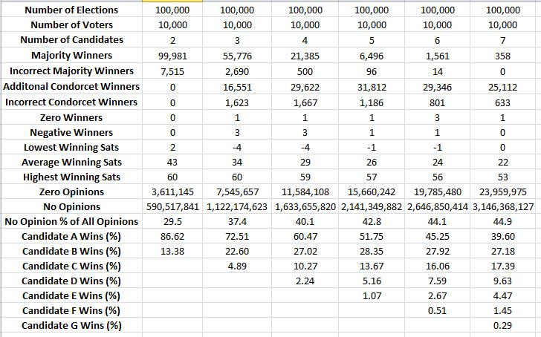

Slide 15
The Most Important Things Learned
Each voter’s choice for the best candidate is the most important single datum. (Plurality depends only on this.)
Each voter’s choice of the worst candidate is the second most important single datum (and it’s almost as important as the first).
It is required to prevent some big blunders (like electing a candidate disliked by the majority).
Without this datum, no distinction can be made between candidates which are disliked and the many “no opinion” candidates.
Divisive candidates with “high negatives” are quite correctly penalized and more broadly acceptable candidates are then more likely to win.

Slide 16
The Most Important Things Learned
Each voter’s choice of the second best candidate is the third most important datum (but it is far less helpful than the first two).
After the top three, more data does not significantly improve decisions. However, accepting more data does allow more garbage data and more opportunity for strategic attack.
Voters rarely have any more data to contribute.
So, collect the three key data items then STOP; no more.

Slide 17
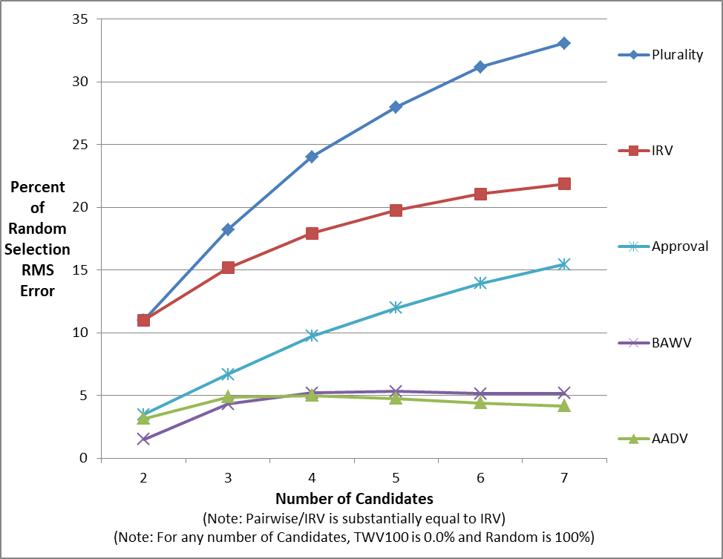

Slide 18
What Are AADV and BAWV?
AADV (Approve/Approve/Disapprove Voting) gives each voter the option to approve of 0, 1 or 2 candidates plus the option to disapprove of 0 or 1 candidate. It is the improved version of AV.
BAWV (Best/Alternate/Worst Voting) allows each voter to pick the candidate they think is best and the candidate they think is worst. They also have the option to pick an alternate best candidate which would be counted only if and when their best candidate is eliminated. It is the improved version of IRV.

Slide 19
How BAWV and AADV Work
The underlying mechanism that makes both BAWV and AADV work so well is that a separate Yes/No referendum is conducted for each and every candidate.
Voters may vote “Yes” in the referendum of the candidate they think is best and “No” in the referendum of the candidate they think is worst.
The candidate which wins its referendum by the largest majority is the winner.

Slide 20
Key Benefits
Enables voters to much more accurately and consistently choose the correct candidate.
Cannot elect a candidate the majority dislikes! (The “NOTA” function is built in.)
Actually reduces (instead of increasing) polarization. Parties can no longer win with polarizing candidates which have “high negatives,” but must instead nominate candidates which have broad support (this is so much healthier)!
Note that these benefits do not depend upon the veracity of the election simulations.

Slide 21
Definitive Recommendation
Plurality voting (and IRV wherever implemented) should be replaced ASAP with either BAWV or AADV. Either is radically better than any other proposed method.
BAWV (Best/Alternate/Worst Voting) has the best performance and has slightly better resistance to strategic voting. Although just as simple for voters, BAWV is more complex to tally (not at all a problem with modern technology).
AADV (Approve/Approve/Disapprove Voting) is nearly as good as BAWV and is very simple in all respects.

Slide 22
BAWV Paper Ballot
Best Alternate Worst
Donald J. Trump X
Joe Biden X
Jo Jorgensen X
Write-in___________

Slide 23
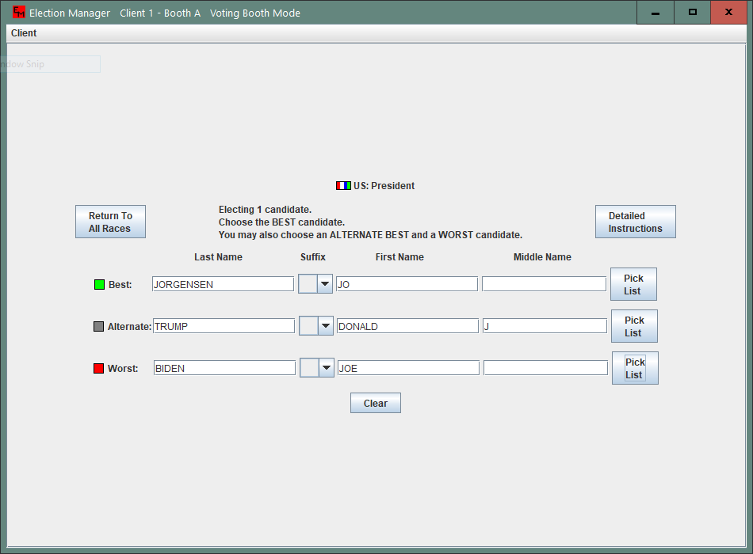

Slide 24
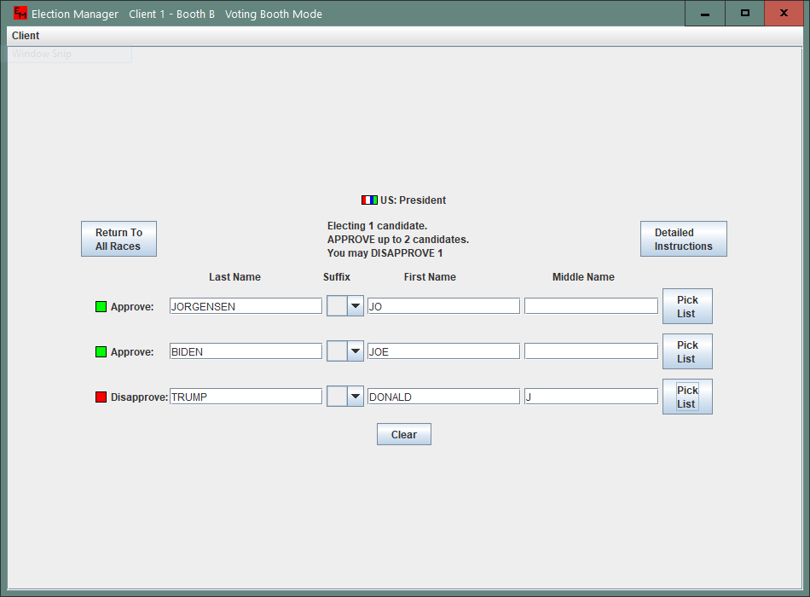

Slide 25
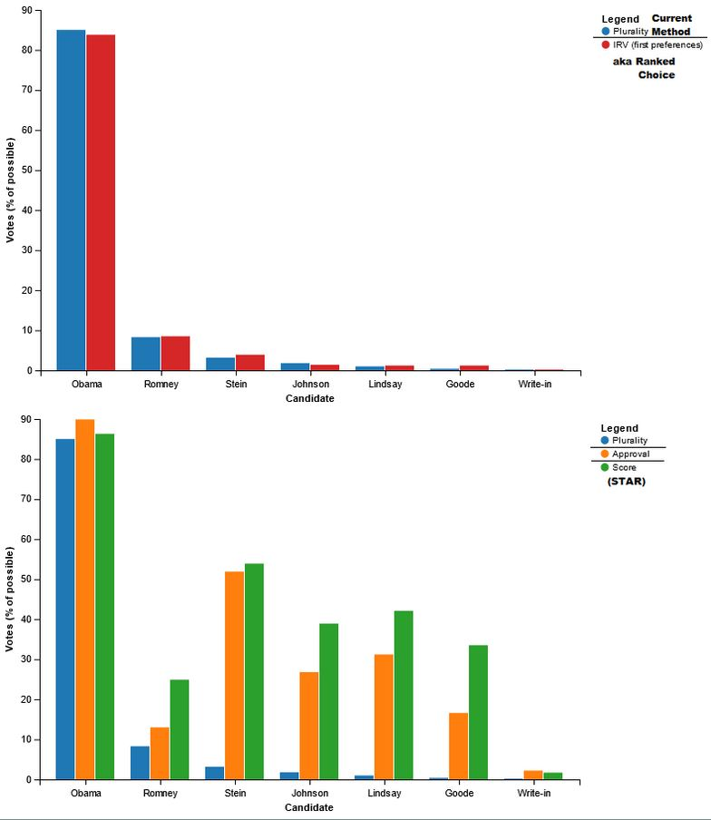

Slide 26
More Information
A comprehensive course on voting methods can be found here:
https://home4liberty.org/courses/
Complete information, including the academic papers on the election simulation projects can be found here:
http://royminet.org/voting-elections/

Slide 27
Instructions For Voters (AADV)
Mark an “X” in the “Approved” box for any one or two candidate(s) (if any) that you really like and believe would be the best one(s) to win this race.
Mark an “X” in the “Disapproved” box for any one candidate (if any) that you strongly believe would be the worst choice and which you would not want to win this race.
If you do not know enough about a candidate or do not have a strong opinion one way or the other, leave both boxes unmarked.
Do not mark more than one box for any single candidate.

Slide 28
Instructions For Voters (BAWV)
Mark an “X” in the “Best” box for one candidate (if any) that you really like and believe would be the best one to win this race.
Mark an “X” in the “Alternate” box for one candidate (if any) that you would like to have counted as your best choice in the event that the candidate you have marked best is eliminated. Note that marking a candidate as alternate cannot help or hurt any candidate and will not count in any way unless and until your best choice is eliminated.
Mark an “X” in the “Worst” box of one candidate (if any) that you dislike and would not want to win this race.
If you do not know enough about a candidate or do not have a strong opinion one way or the other, leave all three boxes unmarked.
Do not mark more than one box for any single candidate.

Slide 29
Instructions For Officials (AADV)
Total the “Approved” votes for each candidate; call this total “A.”
Total the “Disapproved” votes for each candidate; call this total “D.”
Add “A” and “D” for each candidate; call this sum “V.”
Eliminate any candidate whose “V” is less than one plus one percent (rounded to the nearest number of voters) of the largest “V” that any single candidate received.
Subtract “D” from “A” for each remaining candidate; call this difference “N.”
Eliminate any candidate which has a negative N.
The remaining candidate that has the largest “N” is the winner.

Slide 30
Instructions For Officials (BAWV)
Total the “Best” votes for each candidate; call this total “B.” Total the “Alternate” votes for each candidate; call this number “A.” Total the “Worst” votes for each candidate; call this total “W.” Add “B” plus “A” plus “W” for each candidate; call this sum “V.” Compute one plus one percent (rounded to the nearest number of voters) of the largest “V” that any single candidate received; call this number “MV.”
Eliminate any candidate that has a “V” less than “MV.” Upon eliminating each candidate, unmark the “Best” “box” for any ballots which have selected the candidate being eliminated as “Best.” For any ballot on which the “Best” box is being unmarked and for which an “Alternate” is marked, change the “Alternate” candidate to “Best.”
Total the “Best” votes for each candidate; call this total “B.” Subtract “W” from “B” for each remaining candidate; call this difference “N.”
If only one candidate remains and its “N” is not negative, declare that candidate the winner. If either no candidates remain or one remains, but with negative “N,” there is no winner (NOTA won).
Eliminate the candidate which has the lowest positive (or most negative) “N.” (If there should be a tie for lowest “N,” then eliminate the tied candidate which has the lowest “V.”) Unmark the “Best” “box” for any ballots which have selected the candidate being eliminated as “Best.” For any ballot on which the “Best” box is being unmarked and for which an “Alternate” is marked, change the “Alternate” candidate to “Best.” Go back to step 4.

Slide 31
Notes (AADV and BAWV)
Because it is at least a possibility that all candidates on the ballot could be “lackluster,” the winning net vote total could be fairly low (very sad). Conceivably, a write-in (or other obscure) candidate could then achieve a winning score. Therefore, it is required that a candidate must have received at least a “reasonable” amount of voter interest in order to qualify. Therefore, the total number of voters weighing in on each candidate (either for or against) is totaled. Any candidate is eliminated that has a total less than one voter plus one percent (rounded to the nearest voter) of the highest total that any single candidate received.
It is possible, though unlikely, that there could be no winner; that is, no remaining candidate with a positive or zero N. (Candidates with such “high negatives” would simply not be nominated, especially if BAWV or AADV were used during the nominating process!) If there should be no winner, another election should be held. No candidate that received a negative N should be allowed to run again. This is the equivalent of the common practice of always having the option to vote for NOTA (None Of The Above). It is a defect of Plurality, IRV, Approval and virtually all other voting methods that they are unable to sensibly handle this situation (they will instead force the election of a candidate disliked by a majority of voters).
Software is available that handles BAWV, AADV and Plurality.

