Slide 1
Guided Discussion Series
Rational Self Interest
-- How People Make Decisions
Guide: Roy Minet

Slide 2
Why Does It Matter
How People Make Decisions?
Rational self interest is the basis for the entire (critically important) science of economics.
Rational self interest can form the basis for a rational definition of what set of individual rights should be secured. (“Rights” will be our next topic!)
It’s interesting and possibly helpful to understand an important aspect of how all our brains work.

Slide 3
A Simple Verbal Definition of Rational Self Interest
A human being will always make the choice which s/he believes will maximize her or his future happiness. Period.
But what about altruism?

Slide 4
But What About Altruism?
The romantic notion of “altruism” is a fallacy. Strictly speaking, altruism simply does not exist. It is a superfluous word in the English language. People simply are not ever just “nice.” They always act selfishly to maximize their own happiness.

Slide 5
Choosing Between A and B
The brain estimates its “total expected future happiness” that would result if A were chosen. It separately does the same for B. It chooses the option associated with the larger happiness estimate.
Most often, this process is completed quickly (quick estimates), but sometimes it can be laborious and time-consuming for choices which are both important and complex.
At decision time, the brain first makes a quick estimate of how much time can or should be allocated to making the decision.
  Is there a time limit by which the decision must be made?
  If no external time limit, how much time should be allocated based on the importance and complexity of the decision. If a prior calculation was made, does it need to be updated?

Slide 6
Instinct Can Override Rationality
The brain also has a library of “built-in” instinctual responses honed by evolutionary forces (survival of the fittest) over thousands of years.
In “threat” situations requiring very fast decisions, an instinctive response may automatically override the rational decision-making process.
In “intermediate” cases, there can be a “fight” to overrule instinct when the rational process has enough time and concludes that the instinctive decision is not best.
The laws of economics derive from the set of all cases where rational decision making prevails (i.e., when there is no force or imminent threat of force).

Slide 7
The “Happiness Function”
Suppose we have a happiness function “h” which calculates the happiness of a brain at any time “t” -- written “h(t)”.
The function “h” is undoubtedly extremely complicated and depends on a complex set of values that the brain has developed over the years.
We can’t know exactly how h is calculated, but it is useful simply to know that such a function exists for every brain.

Slide 8
A Simple Happiness Function Example
The chart shows h(t) for some brain for two cases: red is the result if it is decided to purchase TV Set A and blue is the result if it is decided to purchase TV Set B. Note the drop in happiness when the products reach the end of their lives.

Slide 9
A Slightly More Difficult Decision
Suppose now that TV Set A is not as good as TV Set B, but it has a longer life. Which is the better choice now?

Slide 10
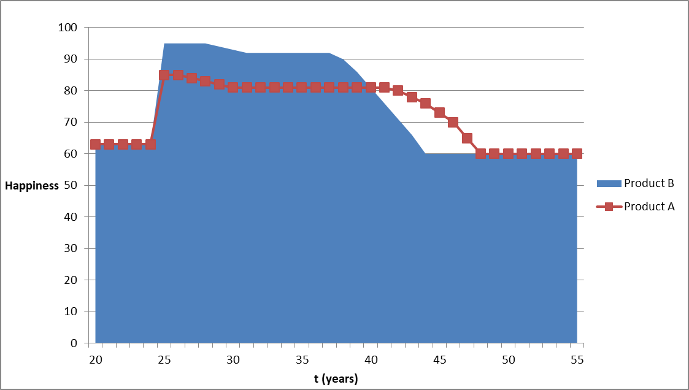
Solution: Compare The Areas!

Slide 11
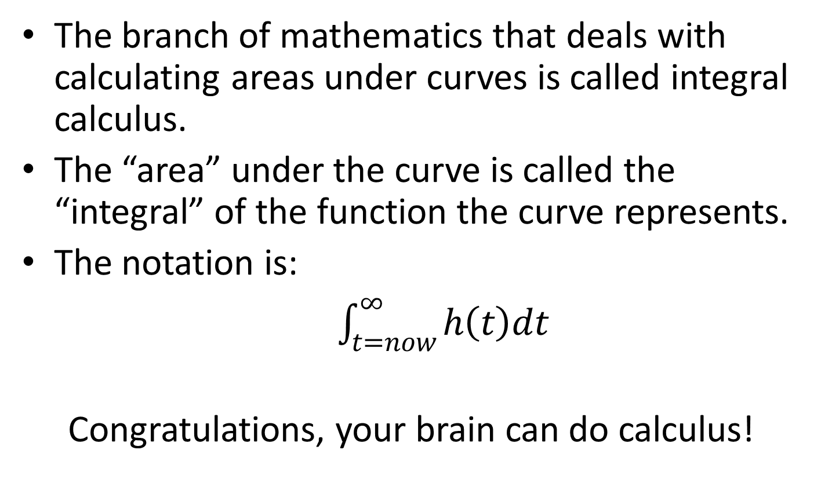
Integral Calculus
The branch of mathematics that deals with calculating areas under curves is called integral calculus.
The “area” under the curve is called the “integral” of the function the curve represents.
The notation is:
$\int_{t=now}^{∞}{h\left(t\right)dt}$
Congratulations, your brain can do calculus!

Slide 12
36-Month Certificate Of Deposit
Should you invest $1,000 in a 36-month CD that yields 4% interest?

Slide 13
Oops, The h(t) Function Is Insufficient
There is an obvious problem when a 100-year CD looks like a good decision! Happiness would be reduced by the initial investment, but you would be dead by the time the benefit is received.
Solution: To make good decisions, future happiness must be “discounted” for the fact that you might not be alive.
The function p(t) is the brain’s expected probability of being alive at any future time, t. It is always a number between 0 and 1. It is always 1 at t=now and always declines monotonically to 0 over a lifetime.
p(t) could be radically affected by circumstances such as a serious or terminal disease or a dangerous occupation.

Slide 14
Examples for p(t)
Blue – Normal life span
Red – Drafted to fight in a hot war for 4 years
Green – Cancer, 25% survival; 10 years off life

Slide 15
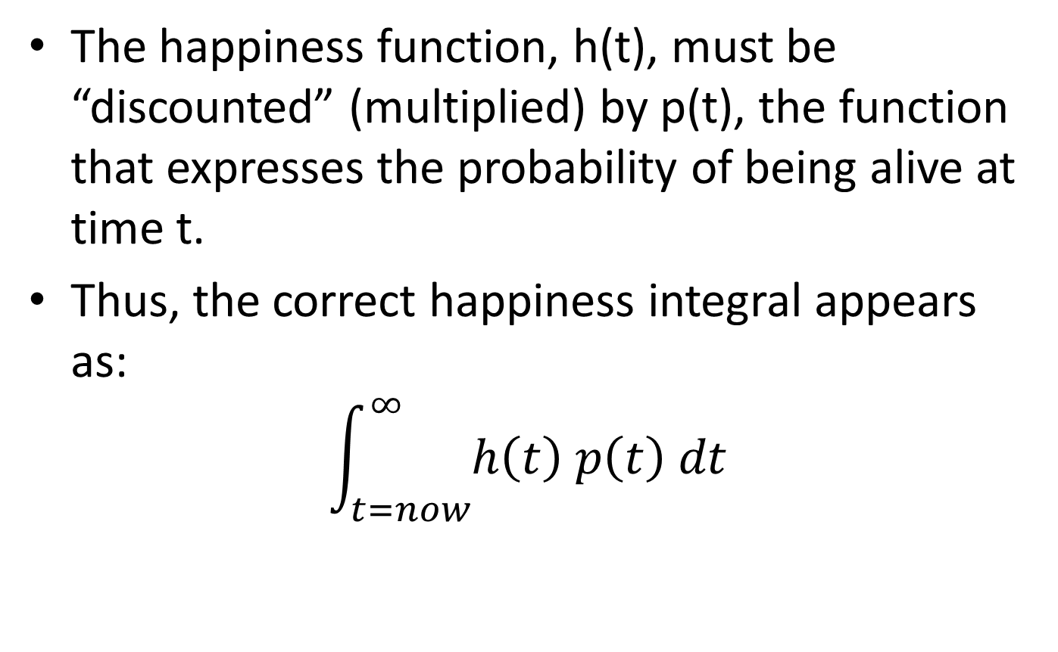
Corrected (final) happiness Integral
The happiness function, h(t), must be “discounted” (multiplied) by p(t), the function that expresses the probability of being alive at time t.
Thus, the correct happiness integral appears as:
$$\int_{t=now}^{∞}{h\left(t\right) p\left(t\right) dt}$$

Slide 16
36-Mo. CD, Normal Life Expectancy

Slide 17
Robbery Example
On a deserted street, a robber points his gun at you and demands that you hand over your wallet.
Your decision is whether to hand over your wallet or to resist.

Slide 18
Robbery Example
Blue: As if the robbery never happens
Red: Acquiesce and hand over your wallet
Green: Resist – 75% chance you’d be shot dead

Slide 19
Now revisit the TV set example with the p(t) correction.
Note how a differing p(t) can cause the decision to go either way.

Slide 20
Good Brains And Bad Brains
Some brains can estimate happiness and life expectancy well, and compute integrals quickly and accurately. They consistently make the best decisions!
Some brains err with p(t) and make decisions almost as though “there’s no tomorrow” – a systematic error.
Some brains are just plain not very good at any of it and make lots of bad decisions.

Slide 21
Caveat Emptor!
The material to which you have just been exposed was entirely generated by Roy Minet.
It is unlikely that you could find anything similar in any text book (or probably anywhere else).
These statements are provided to assist you in judging the veracity of the information.

