Slide 1
Guided Discussion Series Individual Rights Guide: Roy Minet

Slide 2
Impassioned orators, including those in the highest places, sling the noun “right” around as though it were something extremely important about which they have a deep understanding.
In 99% of these cases, the users of this word haven’t given the subject of “rights” much thought.
In 99.9% of the cases (and this percentage could be even a bit higher), the statements they make are incorrect in some sense and the speakers do not have an in-depth understanding of “rights.”

Slide 3
In general, most people have, at best, only a very fuzzy understanding of “rights.”
Frequently, the more passionately they speak, the less they understand!
That’s partly because there are a lot of thoughtless dweebs and partly because the subject actually is more complicated that it would seem.
Let’s put the important subject of rights onto a firm(er) foundation!

Slide 4
Definition of a “Right”
Right – A liberty of action or a benefit that every person is entitled to, that cannot be taken away, and about which everyone agrees.

Slide 5
Negative and Positive Rights
Negative (traditional) rights place no burden or claim upon the resources of others.
Life
Liberty
Positive rights require an expenditure of resources by others to provide/secure the right.
Life (if defined to include shelter and three square meals per day)
Health care (beyond just what you could provide for yourself)

Slide 6
Rights Are Messy!
Even defining a “theoretical right” can be messy (as we will see).
A theoretical right has zero practical or actual value unless it is “secured” (i.e., a “very large” percentage of individuals can actually enjoy the right a “very large” percentage of the time).
Securing a right requires that a “sufficiently large” amount of force be available to suppress violations of the right a “very large” percentage of the time.

Slide 7
History
A succession of scholars/philosophers have worked to develop the theory of rights from the late antiquity period to the present. Life and liberty were main “anchor rights.” Key concepts: “State of Nature” and “Natural Rights”
Thomas Hobbes – Early 1600s
John Locke – late 1600s – Property
Immanuel Kant – late 1700s – Reason
Thomas Jefferson – late 1700s/early 1800s – Pursuit of happiness (instead of property)
Friedrich Hayek – Early 1900s
Murray Rothbard – 1900s
John Rawls – 1900s
Robert Nozick – 1900s
Hans-Hermann Hoppe – Contemporary (UNLV)

Slide 8
From Where Do Rights Come?
From nature – “Natural Rights”
From a deity – “Self-evident rights from Creator”
Rights are granted to people by their government or state
From reason – Employ logic to figure it out
Rights don’t exist – Free-for-all; individuals and/or groups defend what they think are their rights (anarchy)
Contractual – Agreements not to harm or be harmed
Rights evolved over time

Slide 9
Rights of a Lone Individual In a “State of Nature”
Life?
Liberty?
Property?
Health care?

Slide 10
There Is No Such Thing As “Natural Rights”
There is no “list of rights” that are automatically provided for humans by nature or by a deity.
Efforts to justify natural rights have been wishful thinking!
Thinking that there is (or should be) such a list is the ultimate hubris or conceit.
Nature can be counted upon only for the consistent enforcement of the objective laws of physics and the impartial, relentless enforcement of survival of the fittest under these laws.

Slide 11
Empirical Natural Rights
Toward A Theory Of Empirical Natural Rights
by John Hasnas, Georgetown University (2005)
Convincingly argues that the advocates of “Natural Rights’ have not made their case
Proposes “Empirical Natural Rights” instead
“ENR” evolved in parallel with Common Law over a several-hundred-year period in Norman England following the collapse of the Roman Empire in the 5th century.

Slide 12
Rights Are Not Clean and Simple
Even theoretical rights are not “clean” and simple philosophical entities and should deal with where to draw the boundary between “right” and “not a right” in gray areas.
Real-world mechanisms to secure rights are forced to face such issues and tradeoffs as happened with Empirical Natural Rights.

Slide 13
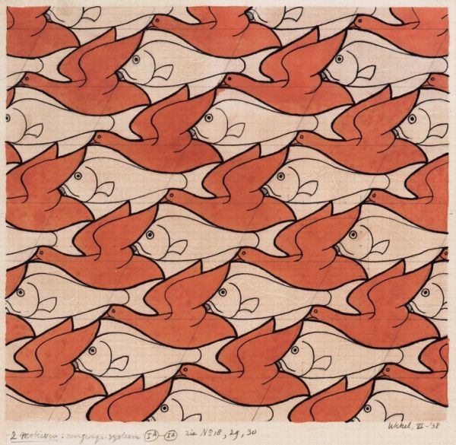
M. C. Escher (1898 – 1972)
Let’s say the birds represent “rights” and the fish represent the power structure that secures them.

Slide 14
Clearing Away All The BS And Fog
The concept of a “right” or a set of “rights” is entirely an invention of the human intellect.
Therefore, rights do not “come from” anywhere.
It is completely up to humans to define what rights are or should be and also to construct the mechanism needed to secure the rights.
As libertarians well know, any mechanism powerful enough to secure rights is powerful enough to take them away – therefore, very dangerous!
Note that in at least one case, anarchy was not stable and evolved a force structure to secure rights.

Slide 15
Should There Ever Be Any Positive Rights?

Slide 16
How Could Rights Be Defined?
Empirical Natural Rights – Rights are anything not illegal under common law.
Non-aggression Principle (NAP) – Rights are anything that does not violate the NAP.
Equal Freedoms – Rights are anything that does not infringe on anyone’s equal rights.
A document (e.g. the US Constitution) that sets up a force structure to secure a set of rights.
Rational Rights – That set of rights which maximizes the total happiness of all people.
${ H}_{i}$ = $\int_{t=now}^{∞}{h\left(t\right) p\left(t\right) dt}$ $H_{T}$ = $\sum_{i=1}^{n}{H_{i}}$
An individual’s expected happiness integral. The sum of all individuals’ happiness integrals.

Slide 17
So, What To Do About Rights?
It is indeed encouraging that all approaches lead to a set of rights that include the Lockean natural rights of life, liberty and property!
We could do far, far worse than the Empirical Natural Rights that evolved with common law.
Rational Rights and rights derived from the NAP or Equal Freedoms do not “come with” any force structure to secure them.
Best Plan: Very carefully design and implement a force structure to secure a “good” set of rights; pay extra heavy attention to safeguards that will keep it under control this time! (This is still risky.)

